Slide 1
MLOps – Exam Project
Marc Sun Bøg (173905)
Kasper Schou Telkamp (s170397)
Jacob Bahnsen Schmidt (s184346)

Slide 2
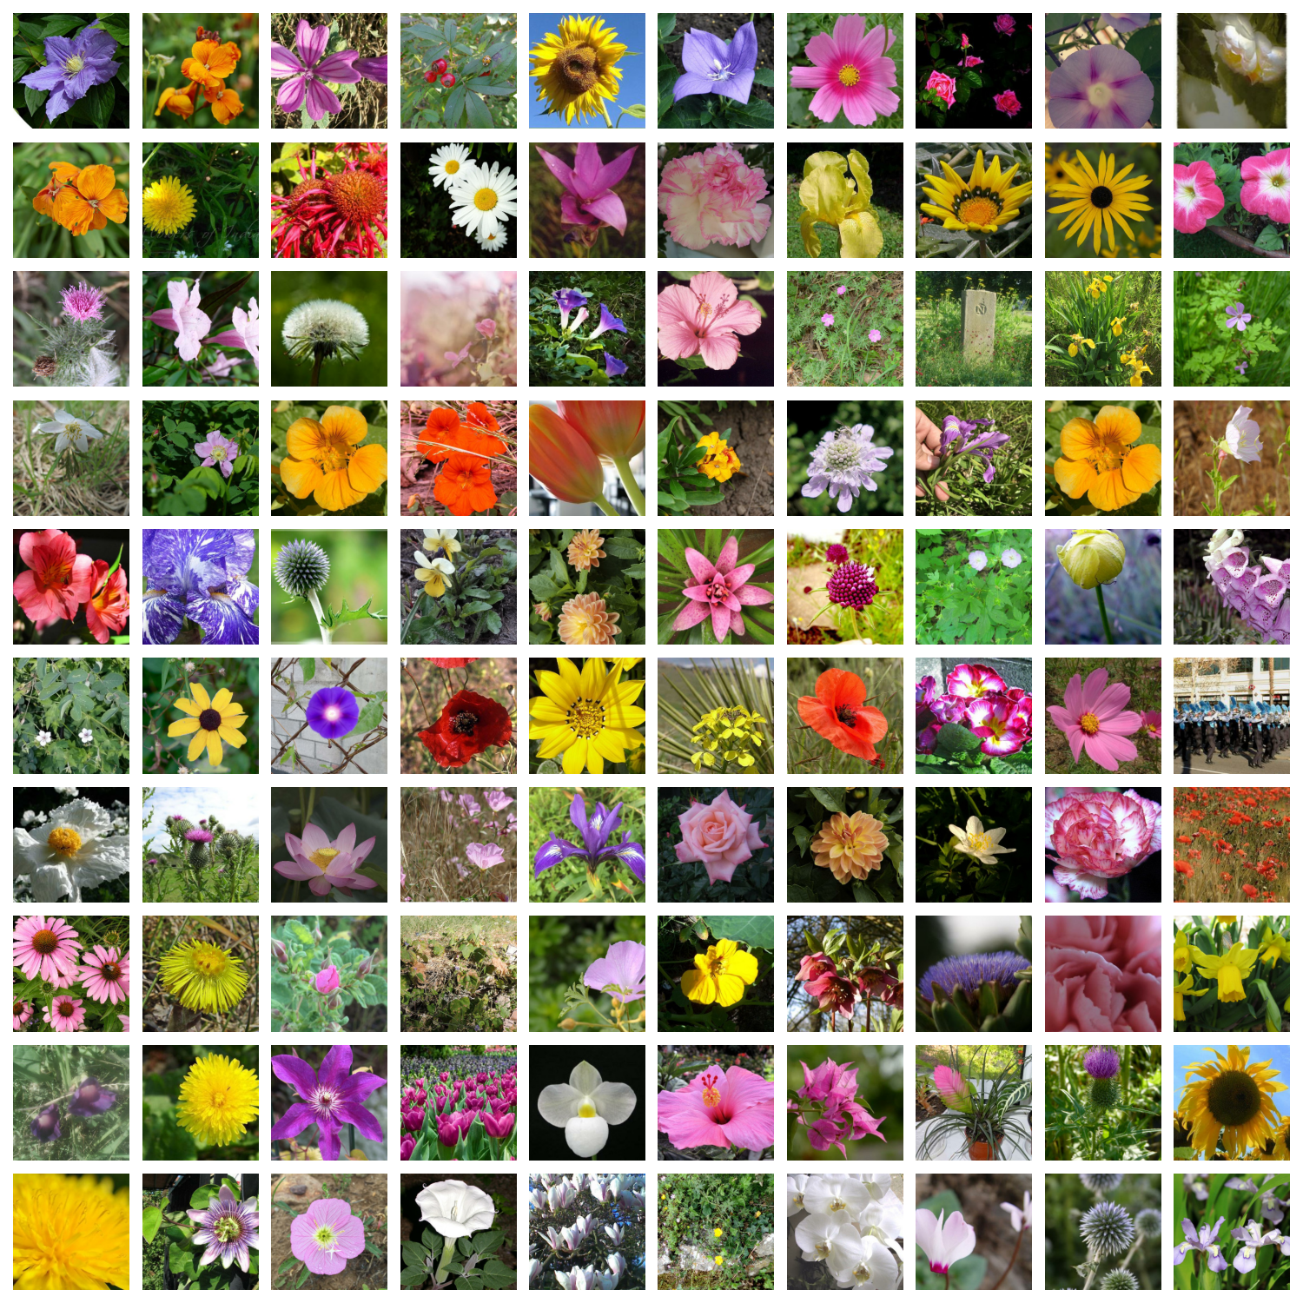
Petals to the Metal Flower Classification
Kaggle challenge
104 classes
Pictures of varying quality

Slide 3
